Slide 1
RETAIL STORE PERFORMANCE
ANKITA ROY

Slide 2
PROBLEM STATEMENT
Enhancing Retail Store Performance Through Data-Driven Insights
Retail organizations strive to optimize store performance, enhance customer engagement, and improve financial outcomes. However, understanding the relationships between key performance indicators (KPIs), operational metrics, and store characteristics can be challenging without effective visualization and analysis tools.

Slide 3
DATA REQUIREMENT
Retail store performance data is acquired from various places

Slide 4
DATA COLLECTION
Through market research data is collected

Slide 5
DATA VALIDATION
Data Completeness: Verify that all entries contain values for each nutritional category.
Data Consistency: Ensure values fall within plausible ranges, e.g., fat values for individual items should generally be less than 100 grams.
Data Cleanliness: Remove any unnecessary columns

Slide 6
DATA PROCESSING
Data Cleaning: Drop unnecessary columns and standardize missing values.
Data Transformation: Normalize or scale nutritional values for easier comparisons, create new metrics if needed
Feature Engineering: Calculate additional metrics
Analysis Preparation

Slide 7
TOOLS
Analytical tool Tableau is used for the visualization purpose

Slide 8
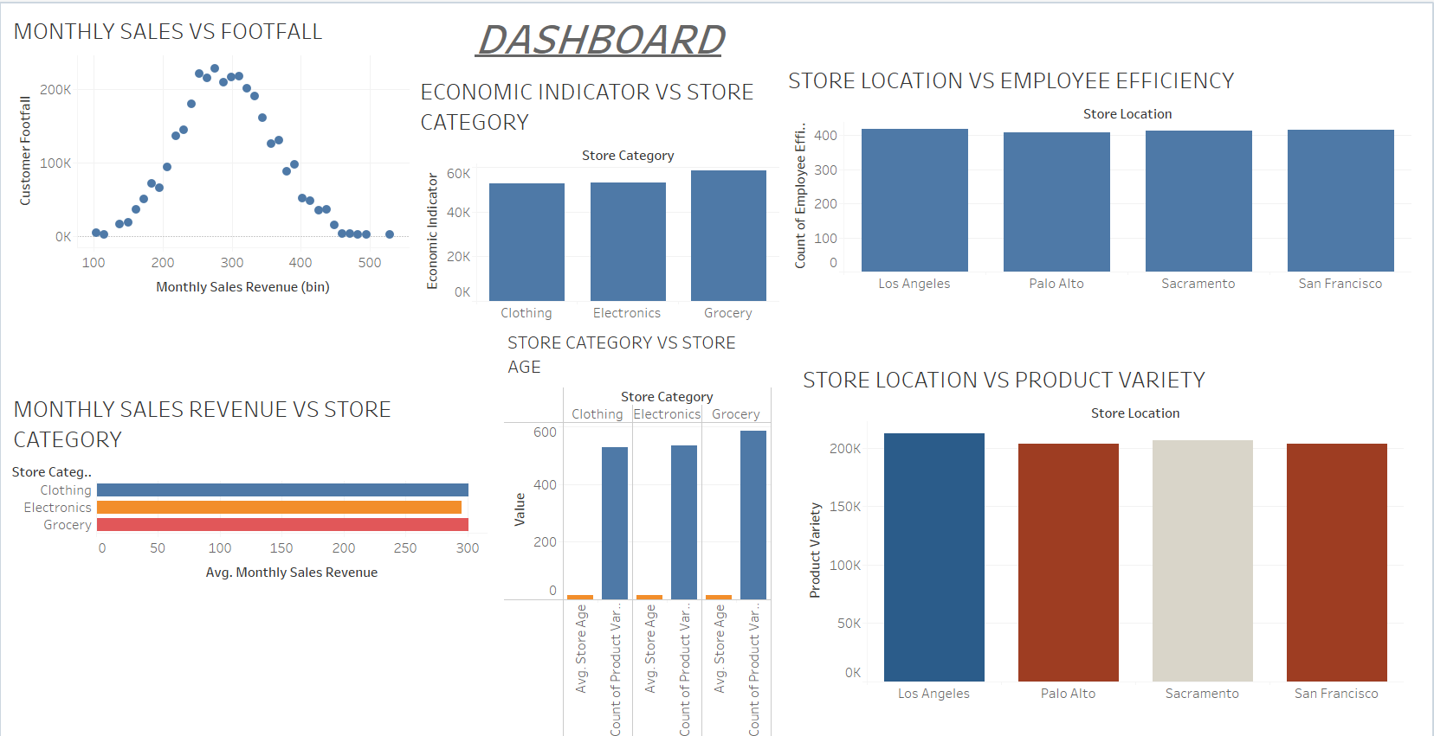

Slide 9
INFERENCES
1. Higher footfall is leading to higher monthly sales revenue
2. Grocery has the highest economic indicator of 58,690
3. Los Angeles store has highest employee efficiency
4. Monthly revenue is highest in grocery followed by clothing then electronic
5. Oldest store sells more of electronics followed by second oldest store sells more of grocery
6. Los Angeles store has maximum product variety

Slide 10
THANK YOU

